Slide 1
Applications of The Derivative Session 8-10
Course : MATH 6031 – Calculus
Year : 2021

Slide 2
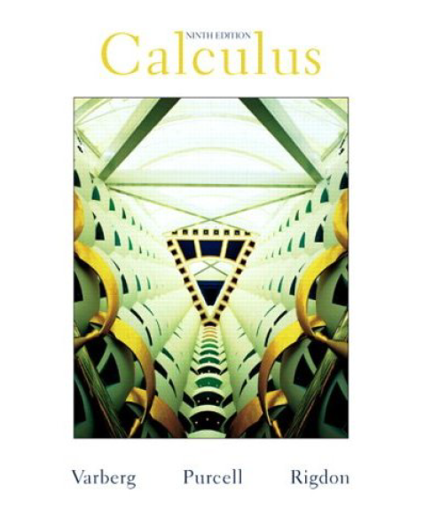
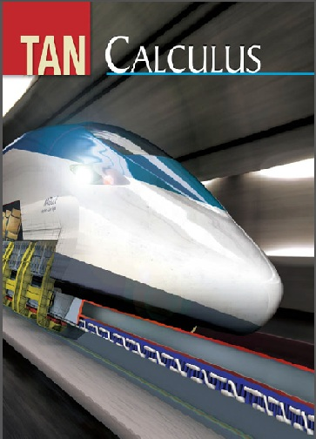
These slides have been adapted from: Dale Varberg, Edwin Purcell, Steve Rigdon. 2007. Calculus. Prentice Hall. ISBN: 978-0132306331. Soo.T.Tan. Calculus. 2010. Brooks/Cole. ISBN-13: 978-0-534-46579-7
Acknowledgement

Slide 3

Learning Objectives
LO 2:
Explain the properties of derivative to describe geometric and physical problems, and other applications.

Slide 4
Content
1
Maxima and Minima
2
Monotonicity and Concavity
3
Extrema
4
Practical Problems
5
Graphing Functions
6
The Mean Value Theorem

Slide 5
Maxima and Minima
Let S, the domain of f, contain the point c. We say that
1
f(c) is the maximum value of f on S if
2
f(c) is the minimum value of f on S if
3
f(c) is an extreme value of f on S it is either
4
The function we want to maximize or
$f\left(c\right)≥f\left(x\right)$ for all x in S
𝑓(𝑐)≥𝑓(𝑥) for all x in S
$f\left(c\right)≤f\left(x\right)$ for all x in S
𝑓(𝑐)≤𝑓(𝑥) for all x in S
minimize is the objective function
the maximum value or the minimum value;

Slide 6
Where Do Extreme Values Occur?
A critical number of a function f is any number c in the domain of f at which f ‘(c) = 0 or f ‘(c) does not exist.
End Points
Stationary Points
Singular Points

Slide 7
The Extreme Value
Guidelines for Finding the Extrema of a Continuous Function f on [a,b]:
1
Find the critical numbers of f that lie in (a,b).
2
Compute the value of f at each of these critical numbers, and also compute f(a) and f(b)
3
The absolute maximum and minimum value of f are precisely the largest and the smallest numbers found in Step 2.

Slide 8
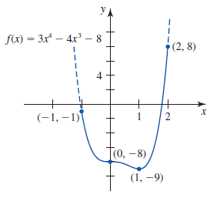

Example 1
If f(x) = 3x⁴ – 4x³ – 8 on [-1,2], then
f’(x) = 12x³ – 12x² = 12x²(x-1)
Setting f’(x) = 0 gives x = 0 or x = 1.
Therefore, 0 and 1 are the only critical numbers of f in (-1, 2).
Next, compute f(x) at these
critical numbers and the endpoints.
The absolute maximum value of
8 at 2 and the absolute minimum
value of -9 at 1.

Slide 9
The First Derivative and Monotonicity
Monotonicity
f is increasing on I if, for every pair of numbers $x_{1}$ and $x_{2}$in I,
$$x_{1}<x_{2} →f\left(x_{1}\right)<f(x_{2})$$
f is increasing on I if, for every pair of numbers 𝑥_1 and 𝑥_2 in I,
𝑥_1<𝑥_2 →𝑓(𝑥_1 )<𝑓(𝑥_2)
f is decreasing on I if, for every pair of numbers $x_{1}$ and $x_{2}$in I,
$$x_{1}<x_{2} →f\left(x_{1}\right)>f(x_{2})$$
f is decreasing on I if, for every pair of numbers 𝑥_1 and 𝑥_2 in I,
𝑥_1<𝑥_2 →𝑓(𝑥_1 )>𝑓(𝑥_2)
f is strictly monotonic on I if it is either increasing on I or decreasing on I.
Monotonicity Theorem
If $f^{′}\left(x\right)>0$ for all x interior to I, then f is increasing on I.
If 𝑓^′ (𝑥)>0 for all x interior to I, then f is increasing on I.
If $f^{′}\left(x\right)<0$for all x interior to I, then f is decreasing on I.
If 𝑓^′ (𝑥)<0 for all x interior to I, then f is decreasing on I.

Slide 10
The Second Derivative and Concavity
Concavity Theorem
If $f^{′′}\left(x\right)>0$for all x in I, then f is concave up on I.
If 𝑓^′′ (𝑥)>0 for all x in I, then f is concave up on I.
If $f^{′′}\left(x\right)<0$for all x in I, then f is concave down on I.
If 𝑓^′′ (𝑥)<0 for all x in I, then f is concave down on I.

Slide 11
Inflection Points
Let f be continuous at c. We call (c, f(c)) an inflection point of the graph of f if f is concave up on one side of c and concave down on the other side

Slide 12
The First Derivative Test
Let c be a critical number of a continuous function f in the interval (a,b) and suppose that f is differentiable at every number in (a,b) with the possible exception of c itself.
1
If f’(c) > 0 on (a,c) and f’(x) < 0 on (c,b), then f has a relative maximum at c
2
If f’(c) < 0 on (a,c) and f’(x) > 0 on (c,b), then f has a relative minimum at c
3
If f’(x) has the same sign on (a,c) and (c,b), then f does not have a relative extremum at c

Slide 13
The Second Derivative Test
Let f be a function such that f’ and f’’ exist at every point in an open interval (a, b) containing c, and suppose that f’(c) = 0
If f’’(x) < 0, then f(c) is a local maximum value of f.
If f’’(x) > 0 then f(c) is a local minimum value of f.
1
2

Slide 14
Practical Problems
Guidelines for Solving Practical Problems
1
Assign a letter to each variable. Draw and label a figure (if appropriate).
2
Find an expression for the quantity to be maximized or minimized.
3
Use the conditions given in the problem to express the quantity to be optimized as a function of one variable. Note any restrictions to be placed on the domain of .
4
Optimize the function over its domain

Slide 15
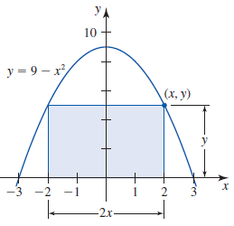
Example: The Maximum Area (1/2)
Problem
Find the dimensions of the rectangle of greatest area that has its base on the x-axis and is inscribed in the parabola y = 9 – x²
Step 1
Consider the rectangle of width 2 and height as shown in Figure
Step 2
The area of the rectangle is and is the quantity to be maximized.

Slide 16
Example : The Maximum Area (2/2)
Step 3
The point (x,y) lies on the parabola, so
Step 4
Setting f’(x) = -6x² + 18 = -6(x² - 3) = 0
Since f” = 12x and
that A = 2xy = 2x(9 – x²) = -2x³ + 18x
so that x = ±√3. We consider only the
critical number √3.
f”(√3) = -12√3 < 0, we see that f
has a relative maximum at x = √3
and it gives y = 6.
Thus, the dimensions of the desired rectangle are 2 √3 by 6 and its area is 12 √3

Slide 17
Graphing Functions method
1
Precalculus analysis.
Check the domain and range of thefunction
(b) Test for symmetry with respect to the y-axis and the origin.
(Is the function even or odd?)
(c) Find the intercepts.
2
Calculus analysis.
(a) Find the critical points and where the graph is increasing and decreasing.
(b) Test the critical points for local maxima and minima.
(c) Find out where the graph is concave up and concave down
3
Plot a few points (including all critical points and inflection points).
4
Sketch the graph.

Slide 18
Example: Graphing Functions

Slide 19
Mean Value Theorem for Derivatives
If f is continuous on a closed interval [a, b] and differentiable on its interior (a, b), then there is at least one number c in (a, b) where:
$$\frac{f\left(b\right)−f\left(a\right)}{b−a}=f^{′}\left(c\right)$$
or
$$f\left(b\right)−f\left(a\right)=(b−a)f′(c)$$
(𝑓(𝑏)−𝑓(𝑎))/(𝑏−𝑎)=𝑓^′ (𝑐)
or
𝑓(𝑏)−𝑓(𝑎)=(𝑏−𝑎)𝑓′(𝑐)

Slide 20
Example: Average Velocity
Problem
Suppose that an
Average
Velocity
The average
Instantaneous
Velocity
The instantaneous velocity is
object has position
function
$s\left(t\right)=t^{2}−t−2$.
𝑠(𝑡)=𝑡^2−𝑡−2.
Find the average
velocity over the
interval [3, 6] and
find the time at
which the
instantaneous
velocity equals the
average velocity.
$\frac{s\left(6\right)−s\left(3\right)}{6−3}=8$
(𝑠(6)−𝑠(3))/(6−3)=8
velocity over the
interval [3, 6] is
equal to
To find the point where average velocity equals instantaneous velocity, equate $8=2t −1$and solve to get $t=\frac{9}{2}$
To find the point where average velocity equals instantaneous velocity, equate 8=2𝑡 −1 and solve to get 𝑡=9/2
$$s^{′}\left(t\right)=2t −1$$
𝑠^′ (𝑡)=2𝑡 −1

Slide 21
Dale Varberg, Edwin Purcell, Steve Rigdon. 2007. Calculus. Prentice Hall. ISBN: 978-0132306331.
Dale Varberg, Edwin Purcell, Steve Rigdon. 2014. Calculus Early Transcendentals. Pearson New International Edition. ISBN: 978-1-292-04268-8
Soo.T.Tan. 2010. Calculus. Brooks/Cole. ISBN-13: 978-0-534-46579-7

